Slide 1
Chapter 11 – Dependability Properties
CSE 319
Software Engineering
Credit Hr. 3.00, Contact Hr. 3.00
Lec Tarannum Zaki
Dept of CSE
MIST

Slide 2
Topics covered
Dependability properties
Availability
Reliability
Safety
Security

Slide 3
System dependability
For many computer-based systems, the most important system property is the dependability of the system.
The dependability of a system reflects the user’s degree of trust in that system.
It reflects the extent of the user’s confidence that it will operate as users expect and that it will not ‘fail’ in normal use.
Dependability covers the related systems attributes of reliability, availability, safety and security. These are all inter-dependent.

Slide 4
Importance of dependability
System failures may have widespread effects with large numbers of people affected by the failure.
Systems that are not dependable and are unreliable, unsafe or insecure may be rejected by their users.
The costs of system failure may be very high if the failure leads to economic losses or physical damage.
Undependable systems may cause information loss with a high consequent recovery cost.

Slide 5
Causes of failure
Hardware failure
Hardware fails because of design and manufacturing errors or because components have reached the end of their natural life.
Software failure
Software fails due to errors in its specification, design or implementation.
Operational failure
Human operators make mistakes. Now perhaps the largest single cause of system failures in socio-technical systems.

Slide 6
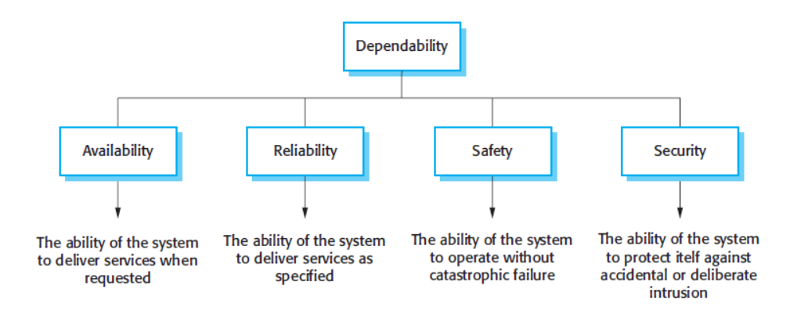
Principal dependability properties

Slide 7
Principal properties
Availability
The probability that the system will be up and running and able to deliver useful services to users.
Reliability
The probability that the system will correctly deliver services as expected by users.
Safety
A judgment of how likely it is that the system will cause damage to people or its environment.
Security
A judgment of how likely it is that the system can resist accidental or deliberate intrusions.

Slide 8
Availability and reliability
Reliability
The probability of failure-free system operation over a specified time in a given environment for a given purpose
Availability
The probability that a system, at a point in time, will be operational and able to deliver the requested services

Slide 9
Safety and security
Safety
The condition of being protected from harm or other non-desirable outcomes, caused by non-intentional failure.
Security
The condition of being protected from harm or other non-desirable outcomes caused by intentional human actions or human behavior.

Slide 10
Other dependability properties
Repairability
Reflects the extent to which the system can be repaired in the event of a failure
Maintainability
Reflects the extent to which the system can be adapted to new requirements;
Survivability
Reflects the extent to which the system can deliver services whilst under hostile attack;
Error tolerance
Reflects the extent to which user input errors can be avoided and tolerated.

Slide 11
Dependability attribute dependencies
Safe system operation depends on the system being available and operating reliably.
A system may be unreliable because its data has been corrupted by an external attack.
Denial of service attacks on a system are intended to make it unavailable.
If a system is infected with a virus, you cannot be confident in its reliability or safety.

Slide 12
Dependability achievement
Avoid the introduction of accidental errors when developing the system.
Design V & V processes that are effective in discovering residual errors in the system.
Design protection mechanisms that guard against external attacks.
Configure the system correctly for its operating environment.
Include recovery mechanisms to help restore normal system service after a failure.
Notes:
Validation is the process of checking whether the specification captures the customer's needs.
Verification is the process of checking that the software meets the specification.

Slide 13
Dependability costs
Dependability costs tend to increase exponentially as increasing levels of dependability are required.
There are two reasons for this:
The use of more expensive development techniques and hardware that are required to achieve the higher levels of dependability.
The increased testing and system validation that is required to convince the system client and regulators that the required levels of dependability have been achieved.

Slide 14
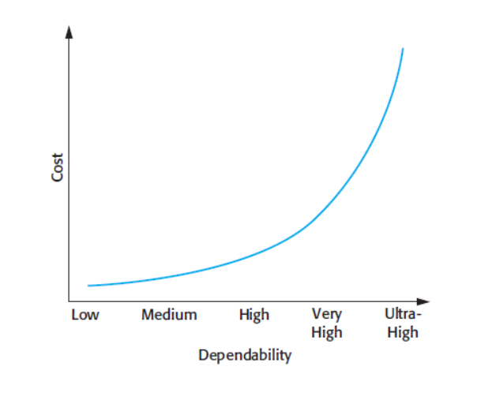
Cost/dependability curve

Slide 15
Dependability economics
Because of very high costs of dependability achievement, it may be more cost effective to accept untrustworthy systems and pay for failure costs.
However, this depends on social and political factors. A reputation for products that can’t be trusted may lose future business.
Depends on system type - for business systems in particular, modest levels of dependability may be adequate.

Slide 16
Fault, error and failure
Fault: It is a condition that causes the software to fail to perform its required function.
Error: Refers to difference between Actual Output and Expected output.
Failure: It is the inability of a system or component to perform required function according to its specification.
Failures are a usually a result of system errors that are derived from faults in the system

Slide 17
Availability assurance
Multiple application servers
When servers become overburdened, they may become slow or even crash. Deploying applications over multiple servers will keep applications running efficiently and reduce downtime.
Spread out physically
Core network servers should not be kept in the same physical location. Having a backup server a few miles away can mean the difference in operating again in a few days versus being shut down completely for months.
Recurring online backup system
Automated backup fills the gap where we manually forget to save and protect files in multiple versions.

Slide 18
Reliability assurance
Fault avoidance
Development technique are used that either minimise the possibility of mistakes or trap mistakes before they result in the introduction of system faults.
Fault detection and removal
Verification and validation techniques that increase the probability of detecting and correcting errors before the system goes into service are used.
Fault tolerance
Run-time techniques are used to ensure that system faults do not result in system errors and/or that system errors do not lead to system failures.

Slide 19
Safety assurance
Hazard avoidance
The system is designed so that some classes of hazard simply cannot arise.
Hazard detection and removal
The system is designed so that hazards are detected and removed before they result in an accident.
Damage limitation
The system includes protection features that minimise the damage that may result from an accident.

Slide 20
Security assurance
Vulnerability avoidance
The system is designed so that vulnerabilities do not occur. For example, if there is no external network connection then external attack is impossible
Attack detection and elimination
The system is designed so that attacks on vulnerabilities are detected and neutralised before they result in an exposure. For example, virus checkers find and remove viruses before they infect a system
Exposure limitation and recovery
The system is designed so that the adverse consequences of a successful attack are minimised. For example, a backup policy allows damaged information to be restored

Slide 21
THANK YOU

